Slide 1


Ingredient To Recipe Generator
Under the Guidance of
Mr. Gunasekar S
Senior Assistant Professor
Department of AI & ML
NHCE
Presented By
Name USN
Puneet Vernekar 1NH20AI082
Kodidala Vamshivardhan 1NH20AI049
Rahul Ravindra 1NH20AI084
From Department of AI &ML

Slide 2
Outline
Introduction
Objectives
Literature Survey
Proposed System
System Design
Implementation
Results
Conclusion and Future Enhancement

Slide 3
Introduction
Human beings require proper food to survive and have a healthy life. Food is a very important component of our daily lives. It is interlinked to every action that we need to perform.
Since food is such an integral part of our live it becomes increasingly clear that we need to prepare and have food that can increase our energy levels and also make us more productive in the process. Our project is used to generate recipes based on the ingredients received by the user.
Our project aims to make sure that the users can create the food that they desire and is fit for consumption without any qualms and can taste different recipes in an engaging manner. Following this will lead to a healthier diet and will have a crucial effect in changing the dietary patterns and the lifestyle of the people.

Slide 4
Objectives
In this project we are making use of deep learning algorithms to make the ingredient to recipe generation i.e., inputting the ingredients and receiving different recipes based on ingredients.
The main aim of our project is to generate different combinations of appropriate recipes, so that the user is provided with diverse options to choose of his own. No matter what the ingredients are, still the model attempts to solve this problem by making the combinations with other ingredients.
The dataset used in this is an recipe dataset which consists of 2 lakh+ data entries so that the model is trained with high accuracy to get an appropriate outputs. This dataset consists of structured cooking recipes which is required to give the proper output.

Slide 5
Literature Survey
Inverse Cooking: Recipe Generation from Food Images. Amaia Salvador, Michal Drozdzal, Xavier Giro-i-Nieto, Adriana Romero- Published in: IEEE(2020) | The image is encoded from the dataset using CNN, ResNet-50, ResNet-101, and DenseNet-121, each trained on the ImageNet dataset. This system takes the input as an food image and generates the recipe and ingredients. | This even gives the approximate content of calories and nutrition value in that food. The dataset used in this model is Recipe 1M dataset. It achieved: recall of 75.47%, precision: 77.13% and accuracy of 55.47%. | As this uses an complex algorithm of ResNet and DenseNet, the time and computing power utilization is high, thus resulting in higher accuracy and low validation errors but consuming more time and power
Food Recipe Recommendation Based on Ingredients Detection Using Deep Learning. Md. Shafaat Jamil Rokon, Md Kishor Morol, Ishra Binte Hasan, A. M. Saif, Rafid Hussain Khan. Published in: ICCA(2022) | They used CNN for identifying 32 different types of ingredients. They used pre trained model called ResNet50. | The dataset used is food 101, fruit 360 and UECfood 256. After running 20 epochs using transfer learning, the proposed CN-based ResNet50 model attained: 99.71% accuracy for the training dataset, 92.6% accuracy on the validation dataset. | It can identify only 32 ingredients. CNN model cannot classify multiple objects. It means that model that model can identify only ingredient at a time.
Recipe Generator using Deep Learning-Disha Moolya1, Sakshi Pansare2, Anushree Kshirsagar3, Prof. Sonali Bodekar-Kale4 Published in: IJRASET(2022) | Natural Language generation has used to produce text from data which use LSTM version of RNN. It Remembers the data for a longer period and forget the information according to the importance. | The dataset used in this model is from Epicurious and recipe box. They used Adam optimizer with 500 epochs and learning rate of 0.0005. It gave least loss. Once ideal parameters were set and valid output generated by the model, it was deployed into a web application. | They did not use any pretrained models for text generation. They can add one features like search by image and search by cuisine type. They can improve their project making recipe generation from title, rather than giving ingredients.

Slide 6
Reference | Methodology | Outcome/Results | Remarks
Identification and prediction of Recipe using deep learning model. Ranjith Reddy, Jogi Krishna. Published in: international journal of creative research thoughts(2022). | CNN model is used which has been trained on recipe details. The system is based on a model called as inverse cooking system which makes use of images. | The model generates cooking recipes based on food images. It uses exhaustive methods to learn the ingredients as both list and set without imposing any order. The dataset used for the model is Recipe 1M dataset. This model achieved an accuracy of 90%. | It gives more recipes than other approaches by utilizing more images. Over a number of epochs the model can differentiate dominant and low level features in images and classifies it.
Cooking recipes generator utilizing a deep learning-based language model. Michal bien, Michal gilski. Published in: reasearch gate(2020) | This project has made use of computational NLP solution that works on machine learning techniques. Another model that has been used is GPT 2 model for generating text of the recipes. | It focuses on the act of creation of new and original recipes which can be passed as human made recipes. The dataset used for the model is Recipe 1M+ dataset. This model achieved an accuracy of 86%. | Automated and manual validation techniques was used for text generated by language models. Additional techniques used included web scraping and exploratory data analysis.
RecipeNet: Image to Recipe/Nutritional information generator. Dorian Raboy-McGowan, Sabrina Lu, Luciano Gonzalez. Published in: Semantic Scholar(2020). | First extract the image representation with a DenseNet-50 encoder and obtain the ingredient embedding using a decoder architecture to predict ingredients. | This recipe generation system takes a food image as an input and outputs a sequence of cooking instructions. The dataset used in this model is Recipe 1M dataset. The cosine loss of this model is 0.719. | This system mainly consists of 3 layers, food understanding- where it identifies the type of food in the image, classification-classifies different food items, text generation- generates the conditional text based on the recipe.

Slide 7
Proposed System
We have made use of Tensor flow and keras framework.
The dataset used in this project contains more than 2 Lakh data entries. This is helpful to create output based on the ingredients given.
Our project aims to provide different combination of recipes based on the ingredients provided by the user.
We used character-level language model based on multi-layer LSTM (Long Short-Term Memory) network (as opposed to the word-level language model).
The ingredients specified by the users will be a key component in the system and our model generates the output.

Slide 8
System Design
We have applied deep learning algorithms to fulfill our objectives. The algorithms used include RNN and LSTM.
The recurrent neural network doesn't understand the characters or words. It understands numbers instead. Therefore, we need to convert recipe texts to numbers.
RNN has been used for the objective of generation of recipes and LSTM is used to store the output of the previous layers.
This LSTM algorithm requires vocabulary component to generate the next character based on the previous character.
Vectorizing the dataset i.e., to map the each characters to their indices because the RNN fails to understand the characters.

Slide 9
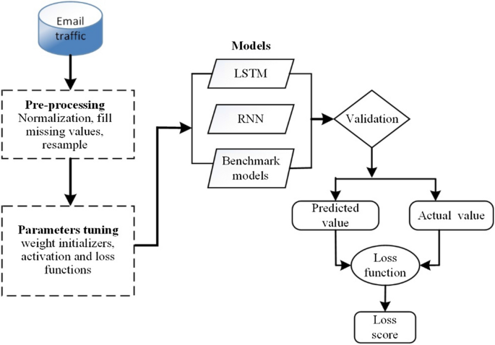
DATASET
Source: https://hcis-journal.springeropen.com/articles/10.1186/s13673-020-00242-w

Slide 10
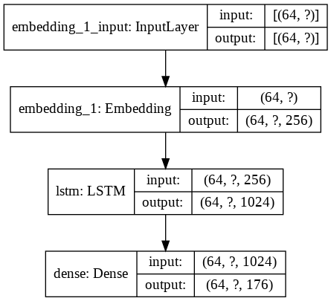
Internal structure of the Model

Slide 11
Flowchart
Collect the data and
Importing dataset
Pre-processing the dataset
Creating vocabulary & performing padding operations
Build the LSTM model
Split the dataset
Converting the dataset into tensorflow dataset
Train the model
Generating recipes

Slide 12
Implementation
We have deployed our project in Microsoft Azure on a virtual machine having Nvidia GPU and 56GB RAM to train our model.
Importing recipe dataset and preprocessing the dataset.
Creating vocabulary and performing padding operations.
Converting the dataset into tensorflow dataset to make use of operations which are not available in pandas.
Split the dataset into training and testing and build LSTM model.
Trained our model with 500 epochs and steps per epoch is 1500 iterations.
Finally we got loss of 1.2134 and there was no improvement in the loss so it was stopped
at epoch 9.This is because of early stopping technique which is used to avoid overfitting
At last inputting the ingredients to generate different combinations of recipes based on the user input.

Slide 13
Steps:
Import all the necessary packages.
Import the dataset.
Pre-process the dataset.
Create the vocabulary array.
Tokenize the data.
Add the padding to the data.
Convert into tensorflow dataset.
Split the sentences.
Create batches.
Build the layers and model.
Add optimizer and loss function.
Train the model.
Generate the recipe.

Slide 14
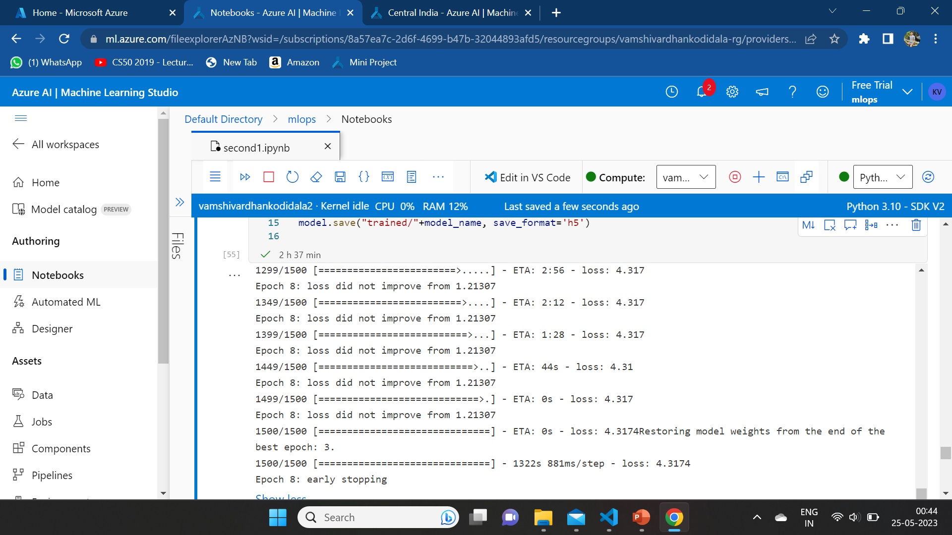
Results

Slide 15
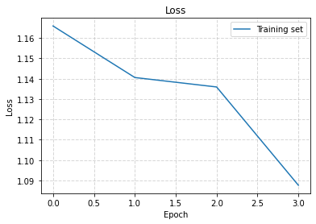
Loss function graph

Slide 16
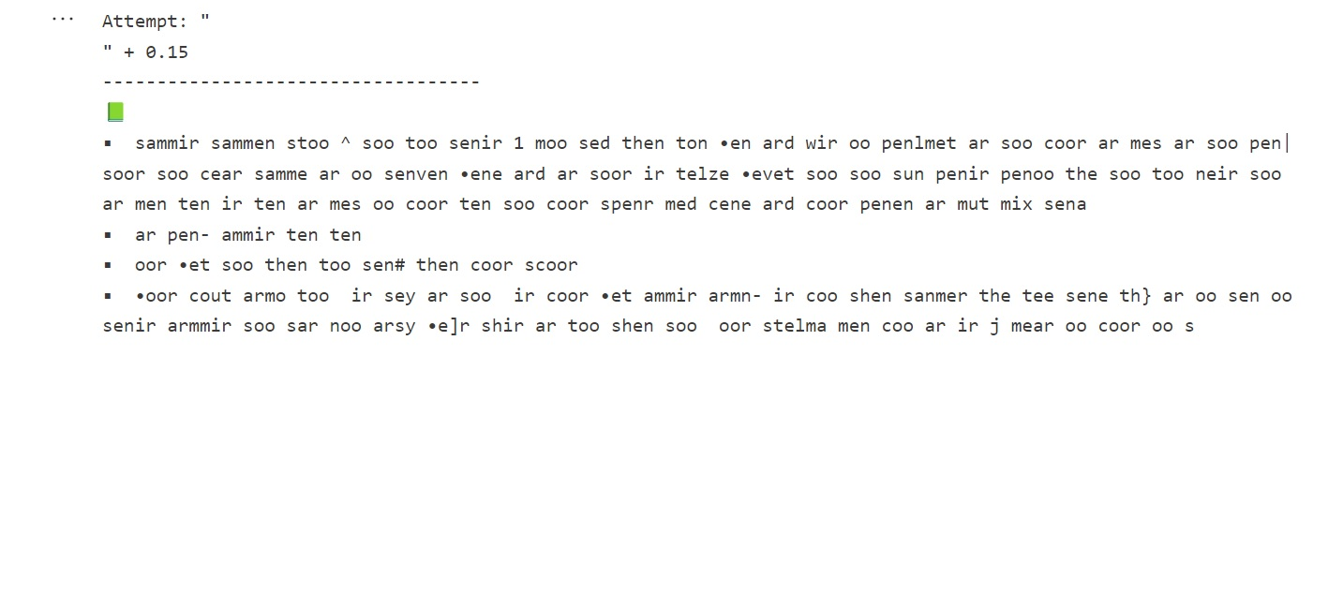
Generated Output

Slide 17
Conclusion and Future Enhancement
From this project we can conclude that the role of food is extremely paramount in our daily lives and it shows us how to make recipes which can help us in this regard.
The project also concludes that the use of deep learning algorithms can be used in the field of cooking efficiently thereby increasing the effectiveness and eliminating the need for extra human interactions.
We can also see that the food recipes generated can be easily generated and can be used to prepare meals based on the convenience of the users.
Future enhancements of our project can include the option of generating recipes from the input consisting of images. This can include a system where only an image of a food item can lead to the generation of the recipes.
Another future enhancement in our project can be to convert our project into a website and upload newer recipes frequently to increase the size of the recipes generated.

Slide 18
Thank You

